Slide 1
IT Infrastructure Architecture
Infrastructure Building Blocks
and Concepts
Introduction to IT Infrastructure
(Chap. 1-2-3)
By
Nauman Irshad
Lecturer- Lahore Garrison University, Lahore

Slide 2
Introduction
IT infrastructures become more complicated
New types of applications:
Big data
The Internet of Thing
Mobility
Cloud computing
Most current infrastructure landscapes are complex
The result of a history of application implementation projects
Specialized hardware and infrastructure components

Slide 3
Introduction
Agile adaptations require infrastructure:
Solid
Scalable
Modular
Architecture is crucial to control the infrastructure when it is designed, in use, and when it is changed.

Slide 4
The definition of IT infrastructure
In literature, many definitions of IT infrastructure are described
Examples:
IT infrastructure consists of the equipment, systems, software, and services used in common across an organization, regardless of mission/program/project. IT Infrastructure also serves as the foundation upon which mission/program/project-specific systems and capabilities are built
All of the hardware, software, networks, facilities, etc., that are required to develop, test, deliver, monitor, control, or support IT services. The term IT Infrastructure includes all of the Information Technology but not the associated people, Processes and documentation
Infrastructure is the shared and reliable services that provide the foundation for the enterprise IT portfolio. The implementation of an architecture includes the processors, software, databases, electronic links, and datacenters as well as the standards that ensure the components work together, the skills for managing the operation, etc.

Slide 5
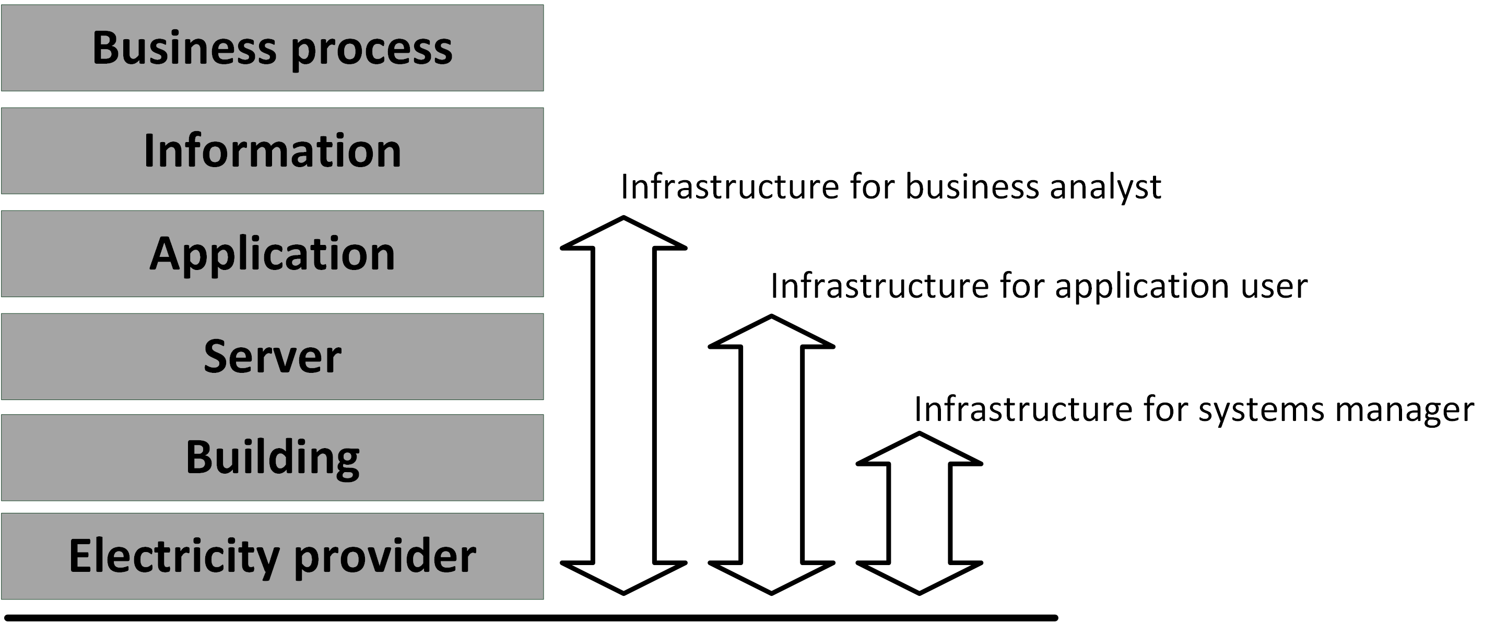
The definition of IT infrastructure
What infrastructure comprises dependents on:
Who you ask
What their point of view is
For most people, infrastructure is invisible and taken for granted

Slide 6
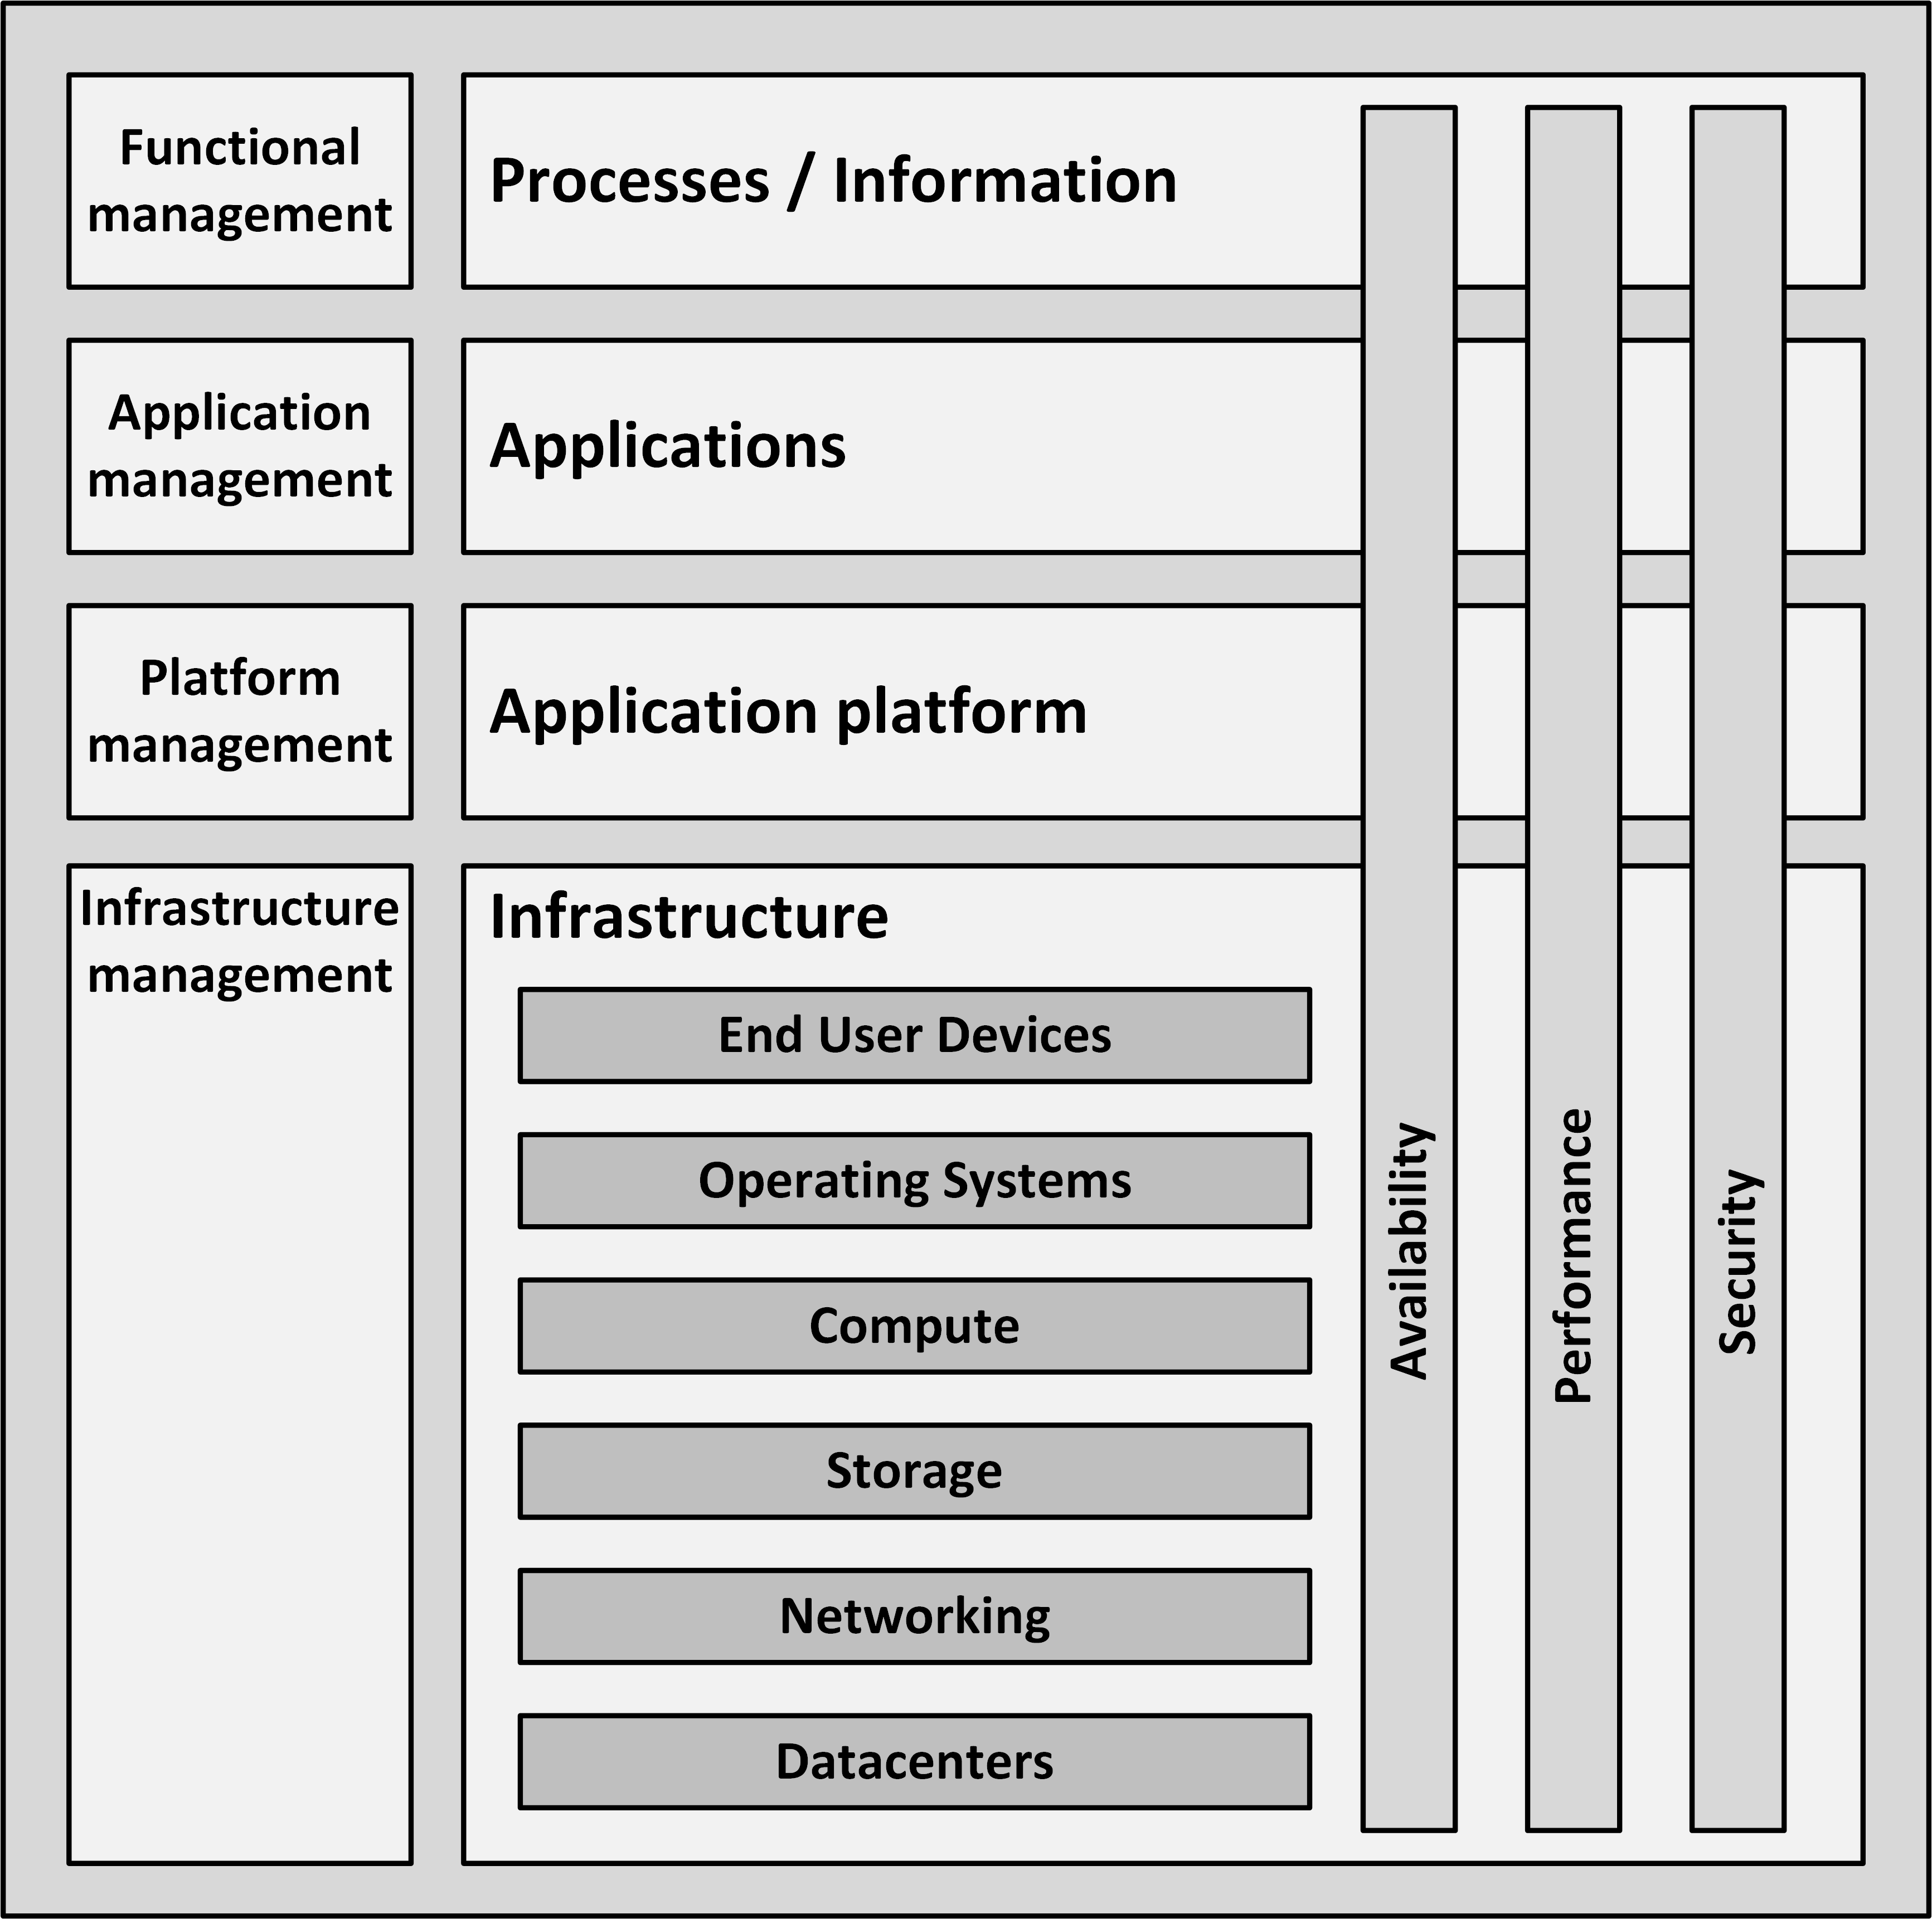
IT building blocks
The definition of infrastructure as used in this course is based on the building blocks in the model below

Slide 7
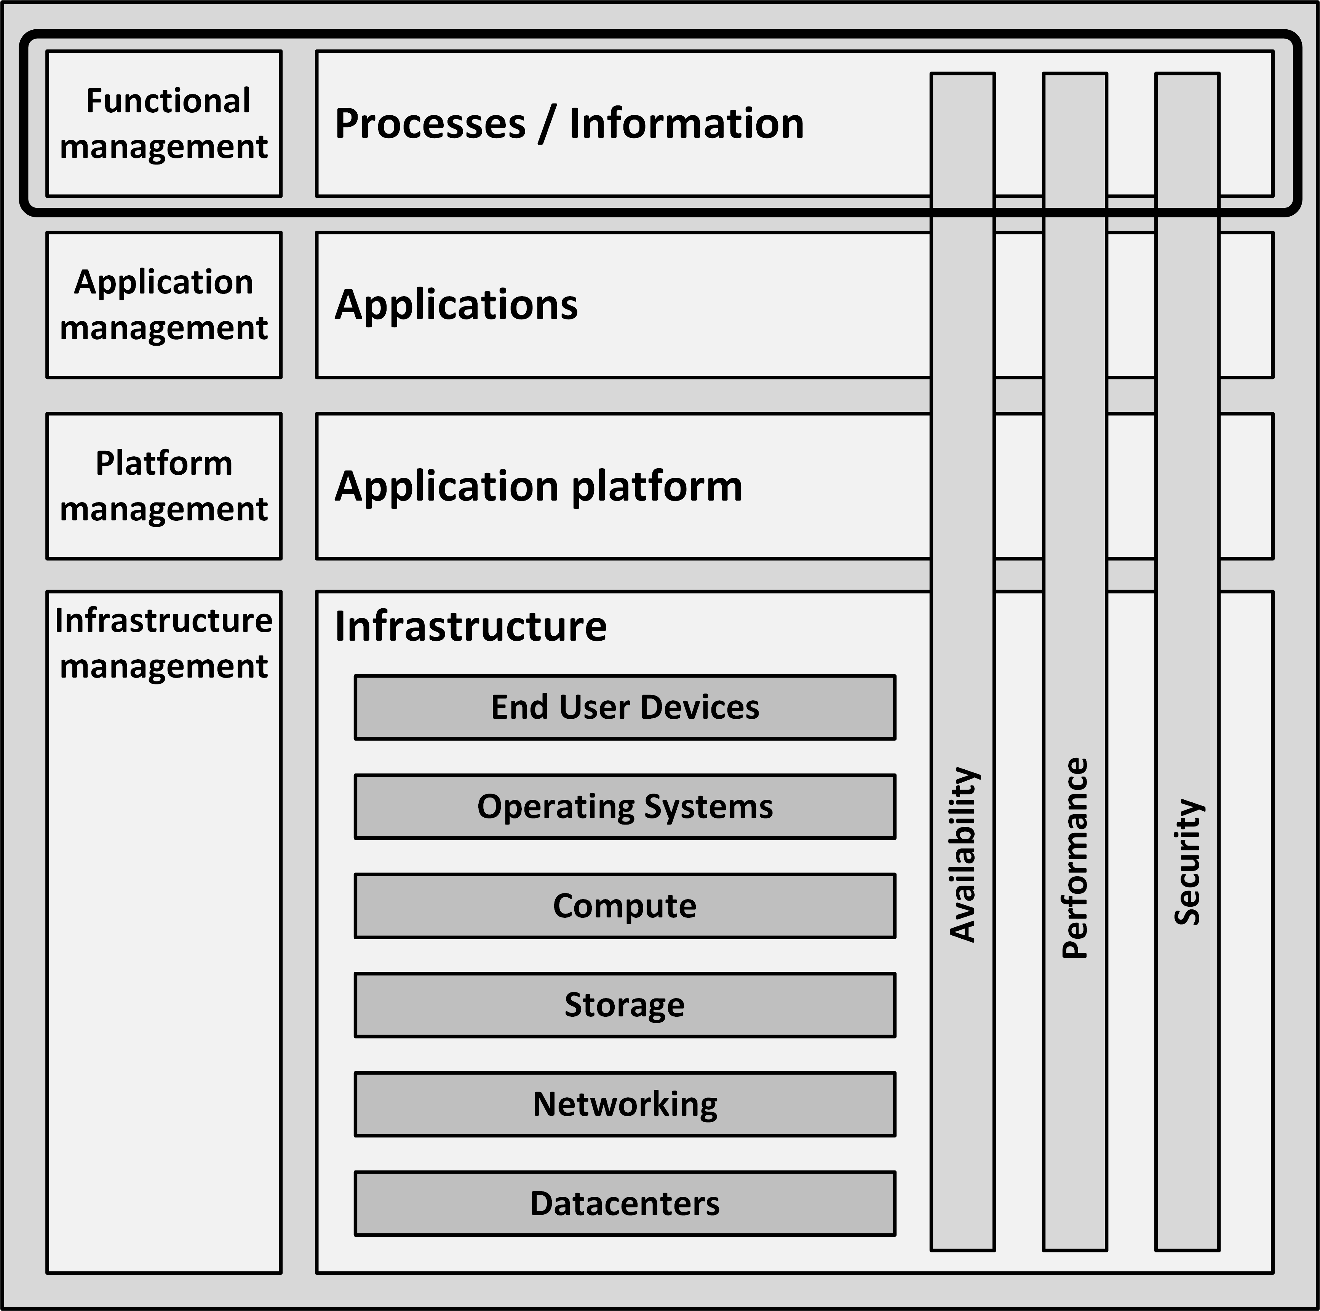
Processes / Information building block
Organizations implement business processes to fulfil their mission and vision
Processes are organization specific
They are the main differentiators between organizations
Business processes create and use information

Slide 8
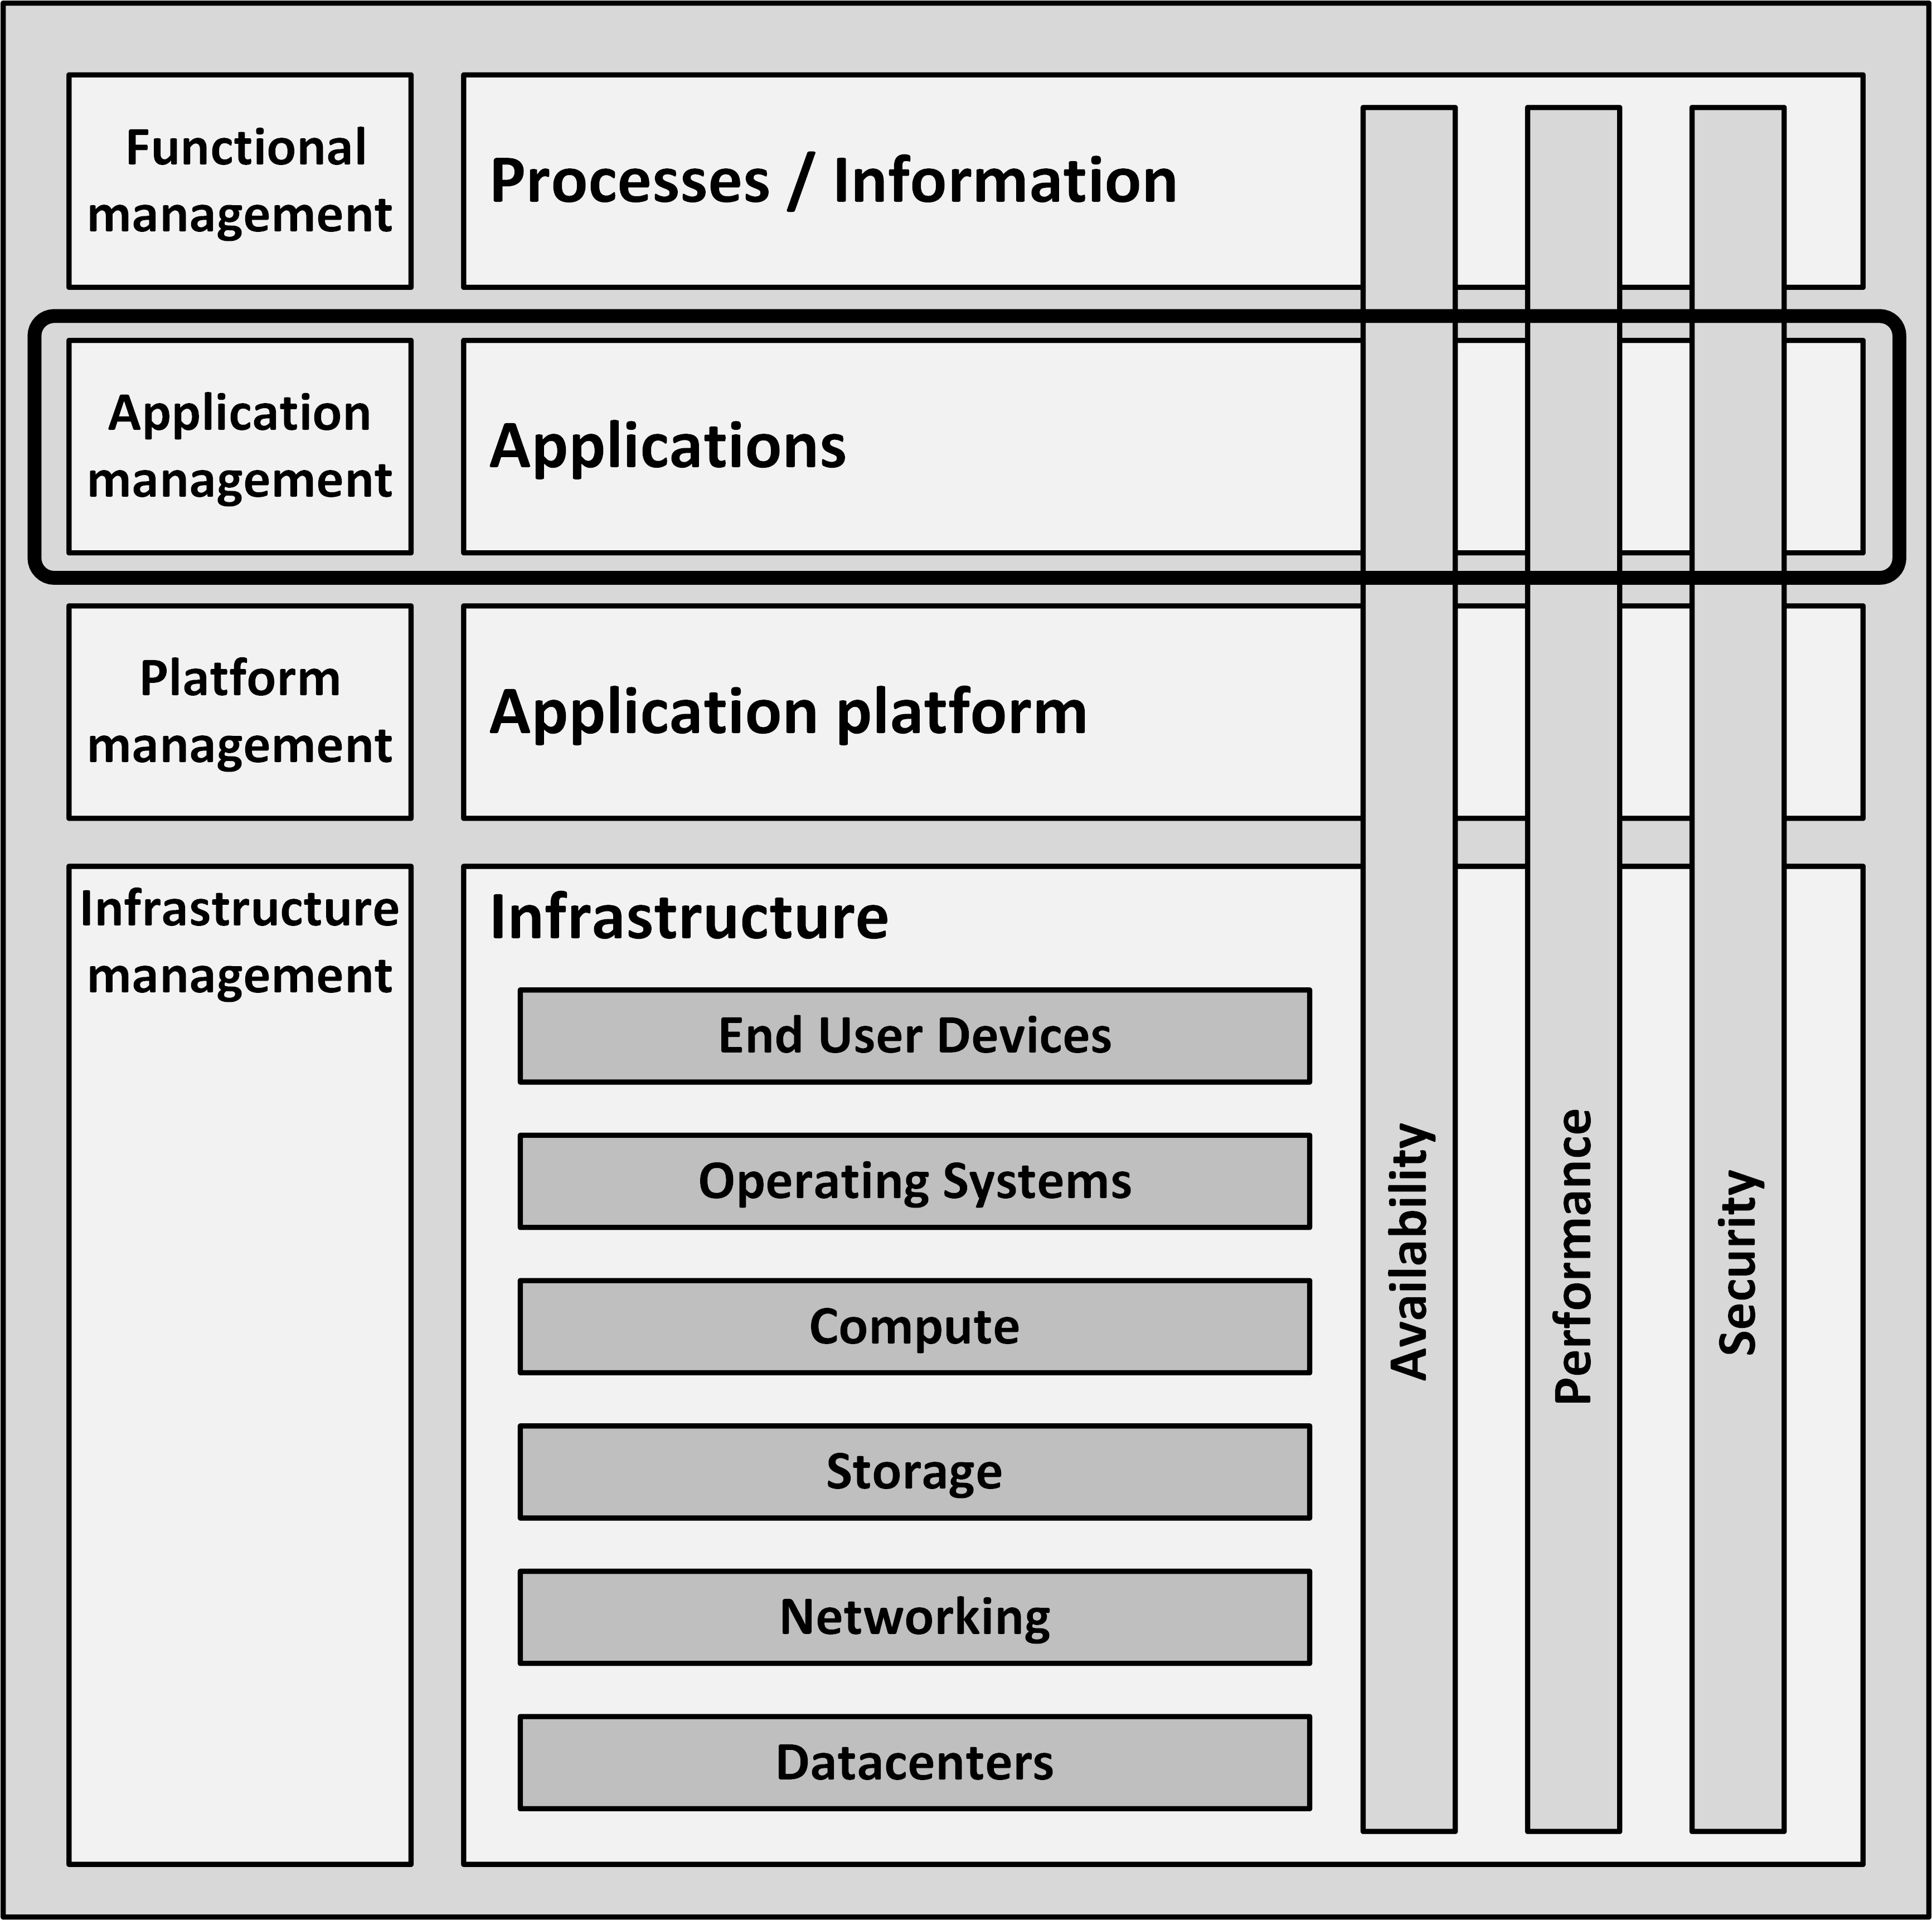
Applications building block
Client applications typically run on end user devices like PCs and laptops
Office applications provide standard server based applications
Business specific applications are typically highly customized or custom built

Slide 9
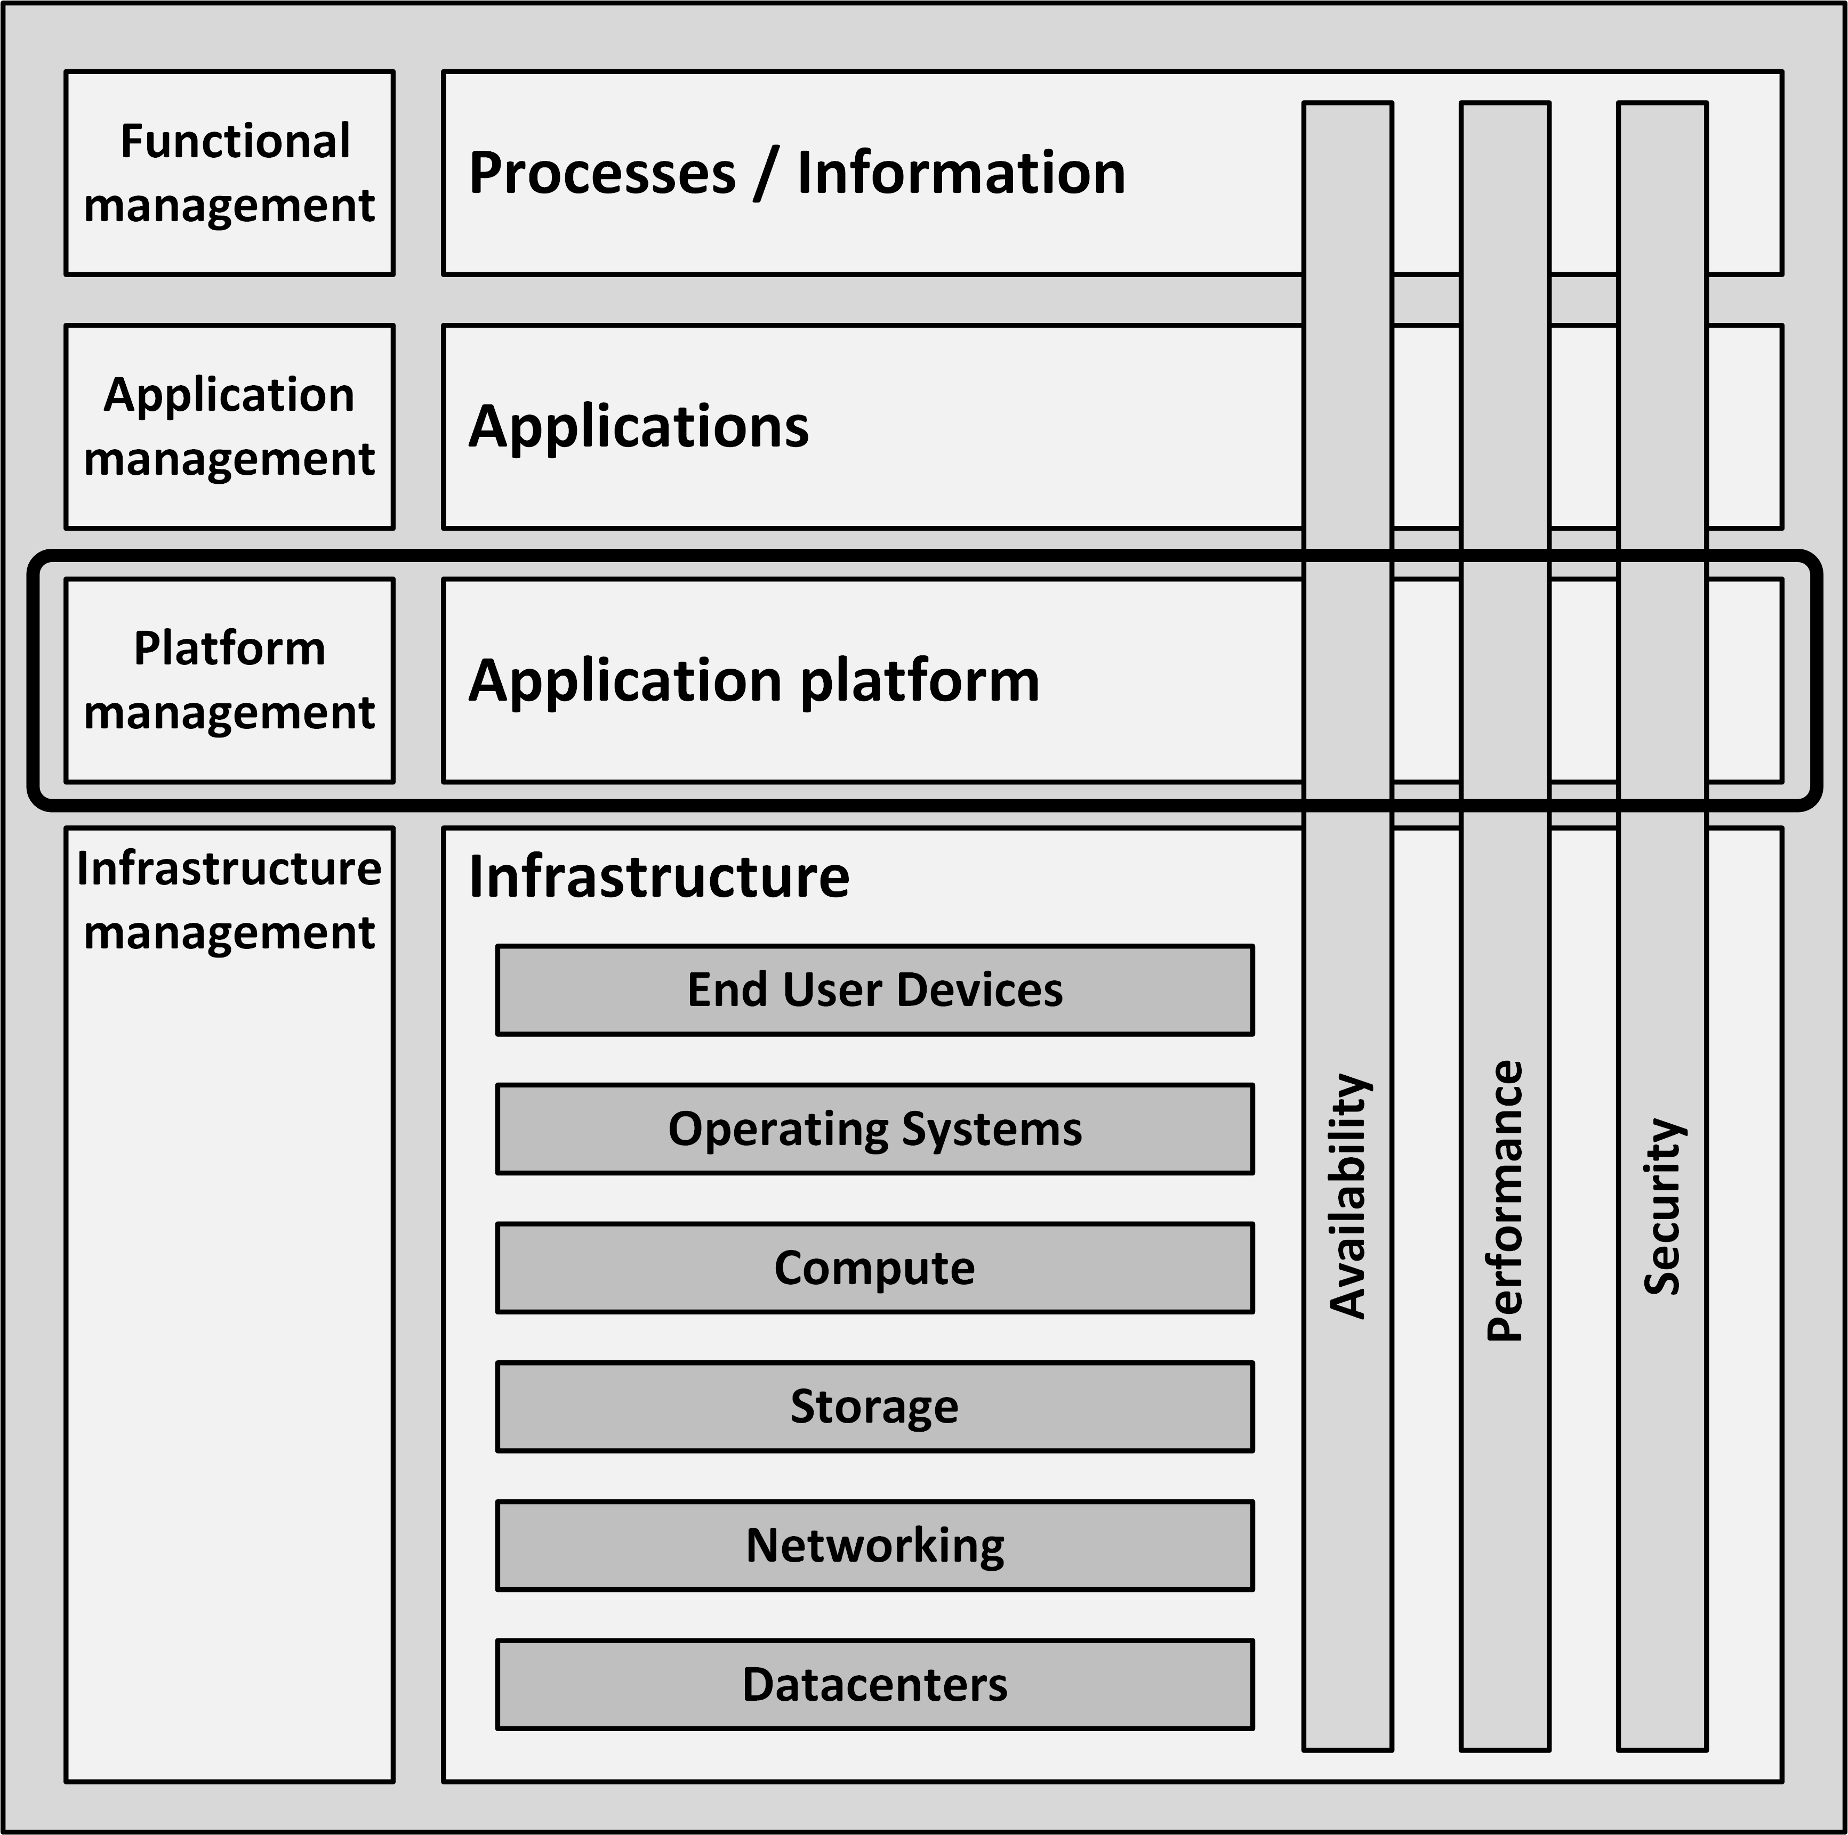
Application Platform building block
Comprises:
Front-end servers
Application servers
Connectivity
Databases

Slide 10
Application Platform building block
Front-end servers provide end users with interactions to applications:
Presenting application screens in web browsers
Application servers act as containers running the actual application
Connectivity entails FTP servers, ETL servers, and ESBs
Databases provide a way to store and retrieve structured data

Slide 11
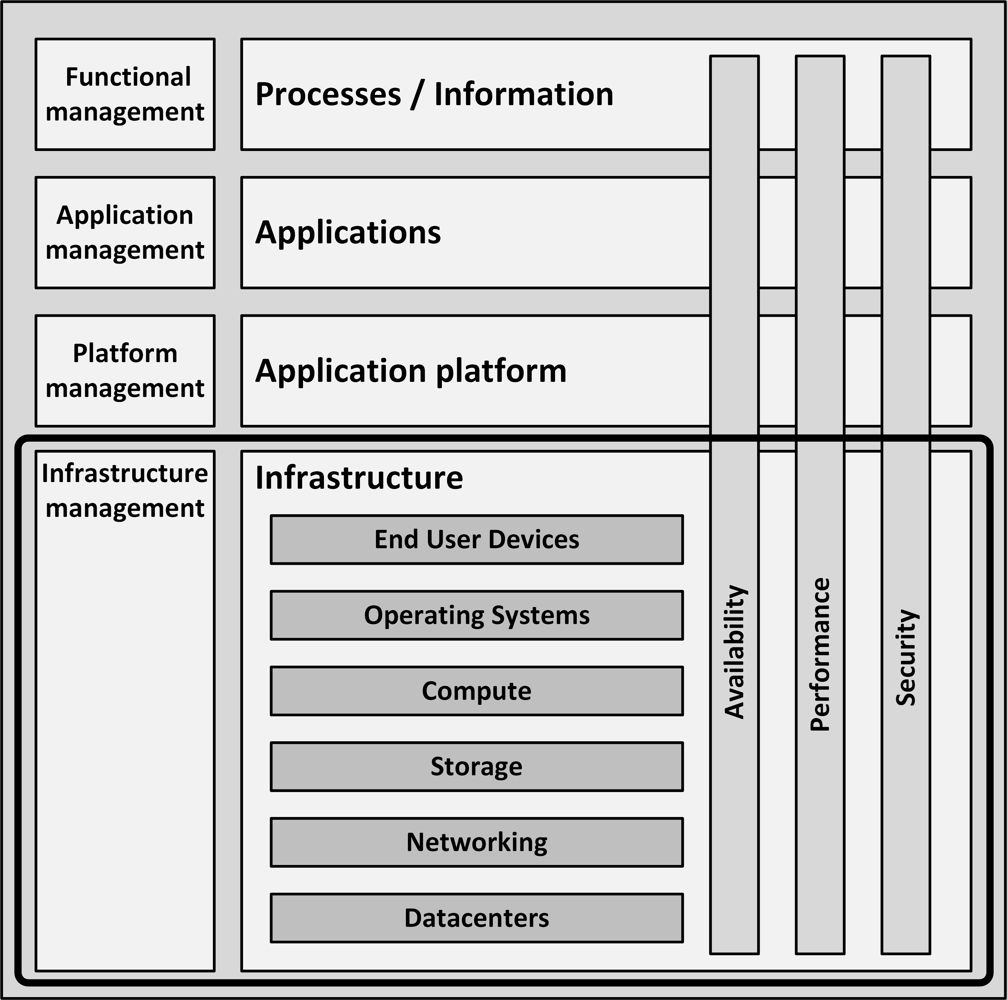
Infrastructure building blocks
Comprises:
End User Devices
Operating Systems
Compute
Storage
Networking
Datacenters

Slide 12
Infrastructure building blocks
End User Devices are the devices used by end users to work with applications
PCs
Laptops
Thin clients
Mobile devices
Printers
Operating Systems are collections of programs that manage a computer’s internal workings:
Memory
Processors
Devices
File system

Slide 13
Infrastructure building blocks
Compute are the physical and virtual computers in the datacenter
Also known as servers
Storage are systems that store data
Hard disks
Tapes
Direct Attached Storage (DAS)
Network Attached Storage (NAS)
Storage Area Networks (SANs)

Slide 14
Infrastructure building blocks
Networking connects all components
Routers
Switches
Firewalls
WAN
LAN
Internet access
VPNs
Includes infrastructure services
DNS
DHCP
Time services

Slide 15
Infrastructure building blocks
Datacenters are locations that host most IT infrastructure hardware
Uninterruptible power supplies (UPSs)
Heating, Ventilation, and Air Conditioning (HVAC)
Computer racks
Physical security measures
Infrastructure management are processes
ITIL
COBIT
DevOps
Tools are used for:
Monitoring
Backup
Logging

Slide 16
Infrastructure building blocks
Infrastructure building blocks are not per definition hierarchically related!
For instance, servers need both networking and storage
Both are equally important

Slide 17
Introduction to Non-functional attributes

Slide 18
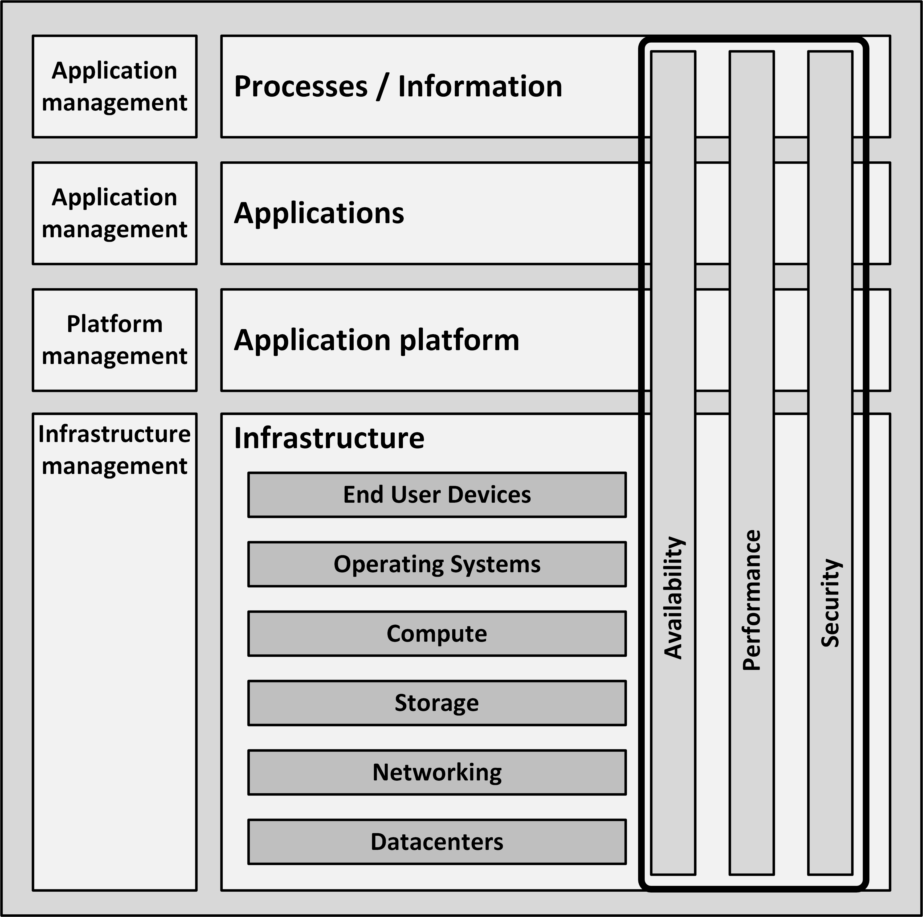
Non-Functional attributes
Non-functional attributes describe the qualitative behavior of a system
Essential in IT infrastructure architectures:
Availability
Performance
Security

Slide 19
NFRs
The name “Non-functional attributes” suggests they have no function
They are very important for the successful implementation and use of an IT infrastructure
The term non-functional requirements or NFRs is frequently used and widely known
The acceptance of a system is largely dependent on the implemented non-functional requirements

Slide 20
Conflicting NFRs
Many of the non-functional attributes are delivered by the infrastructure
Non-functional requirements are often conflicting:
Security versus user friendliness
Performance versus cost
The infrastructure architect should present stakeholders with these conflicting requirements and their consequences

